Slide 1
Board of Trustees Orientation
Part II
January 6, 2023

Slide 2
Orientation Topic Areas
Overview and History
Legal Issues:
Statutes
Legal Issues:
Sunshine Law
Legal Issues:
Board Policies
Legal Issues:
By-Laws
Strategic Plan and Theory of Change
Trustee
Duties & Responsibilities
Board Committees
Financial Overview
Staff
Community Investments & Strategic Initiatives
Allocations & Grant Making
Notes:
CASSANDRA

Slide 3
Strategic Plan &
Theory of Change
Notes:
CASSANDRA
I will provide a brief overview of the strategic plan and theory of change that guide our daily work at MHB. Our strategic plan follows a calendar year. We’ve made good progress with our current plan and are on track to meet all of our milestones by December 2023. In a future board meeting we will discuss what needs to be done to refresh or renew our plan to set goals and objectives for the next three years. We will likely recalibrate our timeline to align with our fiscal year which is July – June, so there may be overlap in wrapping up activities in the current plan and launching our new plan.

Slide 4
Strategic Opportunities & Milestones
Promote and implement equitable, high impact service systems and practices
  Complete a Roadmap to Community Change to guide investments focused on critical need
  Develop early childhood program allocation process for new CCSF funds
  Synchronize the children and adult allocation funds to allow for comprehensive approaches and reduce unnecessary barriers
  Adopt an equity framework and best practice service models based on selected priorities
Notes:
CASSANDRA
Like most plans, we used a SWOT analysis to understand our operating environment. You will see that our plan uses the term Strategic Opportunities, instead of goals. This is done to convey the importance of maintaining a plan that is responsive and flexible. There are 4 strategic opportunities that guide our work. The next few slides present the milestones that we set out to reach under each strategic opportunity.
Roadmap to Community Change is our Theory of Change which was adopted by the Trustees November 2021
CCSF process included new EC program
We currently have hybrid contracts that you will learn more about later that use both tax funds to support a single project. However, this strategic opportunity was not initially approved by the Board of Trustees when we were planning our grant cycles last year. During the upcoming board retreat, we plan to revisit the original concept of combining the CCSF & CMHF proposals into one process to achieve our desired result of streamlining service delivery and improving outcomes for children and families.
Two MHB team members have begun drafting an equity framework that we used as a starting point when designing our CCSF FY23-25. The staff work has paused as we bring on new team members and reassign roles. In the meantime, the Board Chair, Deputy Director, and myself are participating in FTF Racial Equity Cohort

Slide 5
Strategic Opportunities & Milestones
Maximize All Resources for Greatest Impact
  Verify advisability of establishing an affiliated 501c3 entity and implement next steps based on recommendations
  Design and maintain data system that captures MHB Theory of Change & reports on grantee data including outcomes and indicators for each program area
  Develop fund allocation that supports key MHB equity and best practice priorities
  Train and engage trustees and staff to advance key Strategic Plan goals (Maximize human capital – Make most effective use of trustee and staff expertise.)
  Identify opportunities to access unused/underspent funds from all available resources (Maximize financial capital – Increase and leverage diverse funding to expand behavioral health services and system building.)
Notes:
CASSANDRA
I will highlight a few milestones that demonstrate how we think about impact.
Later in the presentation we will talk in greater detail about our current fund allocation process. Here I want to point out that we are a learning organization that is always thinking about continuous quality improvement of our funding process. This means enhancing our current grantmaking processes, as well as considering new funding mechanisms that might be better suited for smaller community-based organizations or organizations that are focused on an emerging need. This could include other ways to identify investment opportunities that don’t solely rely on grant applications.
The training and engagement milestone reinforces our learning agenda. Last fiscal year all MHB staff completed Mental Health First Aid Training and Alive and Well Trauma Awareness training. This year, staff will complete Youth Mental Health First Aid training. We are considering a menu of trainings that we think might also be appropriate for trustees to level set our knowledge of basic mental health concepts, programs, and practices. We also intend to integrate more opportunities to learn about regional issues and initiatives through board presentations, special meetings, and retreats that will allow us to take a deeper dive on critical issues.
This last milestone really speaks to the importance of expanding the pool of resources that are available to support programs and initiatives. This could take the form of adding more Medicaid Match programs to our portfolio, we currently have one for Adolescent C-STAR outpatient substance use services for youth ages 12 - 17, increasing federal grant revenue, and managing private foundation grants. This is a strategy that has significant potential for growth, and we will be discussing this more during our retreat.

Slide 6
Strategic Opportunities & Milestones
Champion Community Knowledge and Field Building
  Develop and implement a strategy for integrating community and family voice along with professional input
  Develop a list of community, state, and national initiatives and select those from which MHB should learn or participate in and MHB's role in each
Tailor Communications & Messaging for Meaningful Impact
  Establish framework and methods for shared decision-making including staff, trustees, and community representatives
  Implement both external and internal communications plans
  Make improvements to grantee review and engagement processes based on assessments and grantee feedback
Notes:
CASSANDRA
MHB has been leading the way for several years in demonstrating the value and importance of including community members in decision-making processes. Through a five-year partnership with the City and County health departments, called RECAST, we helped design and support a regional participatory budgeting process in which community members voted to allocate funding for community projects. MHB has provided technical assistance and consultation to peer funders to help them integrate community reviewers into their decision-making processes. Lastly, MHB has staffed community reviews for City departments to ensure community participation in allocation decisions related to public health and public safety. We continue to build out our capacity to teach government and foundation partners how to engage community and of course we rely on community reviewers for our own grant review process.

Slide 7
Theory of Change (November 2021)
Notes:
CASSANDRA
Now I want to show you how all of what you’ve just heard comes together in our Theory of Change. At the core of our Theory of Change is a belief that People must be at the Center of everything we do. We adapted the University of Pennsylvania’s Center for High Impact Philanthropy 5 Strategies to Address Mental Health & Addiction which emerged as the most promising ways for philanthropy to better address mental health disorders and addiction in the U.S. The model was developed by the Center using the best available evidence synthesizing academic literature, research, and existing frameworks while incorporating the perspectives of donors, clinicians, and practitioners. Additionally, in the process of developing the model the Center engaged individuals with lived experience, along with their caregivers and incorporated more than 50 experts in workshop and small group settings. The five purple circles in the middle contain populations of focus and a brief description of the types of interventions that are most impactful for each population.

Slide 8

MHB’s Strategic Approach
INVESTING
MHB builds capacity in the City of St. Louis through funding, relationship building, and technical assistance for organizations who serve the behavioral health needs of City residents
PARTNERING
By leveraging other funding sources and regional relationships, MHB supports multi-sector partnerships to build equitable, just systems of behavioral health and related services
EMPOWERING
Community-driven solutions inform MHB’s efforts by highlighting gaps, inequitable root causes, and opportunities for innovation
Notes:
CASSANDRA
Partnering—by leveraging other funding sources and regional relationships, MHB supports multi-sector partnerships to build equitable, just systems of behavioral health and related services
Investing—MHB builds capacity in the City of St. Louis through funding, relationship building, and technical assistance for organizations who serve the behavioral health needs of City residents
Empowering—Community-driven solutions inform MHB’s efforts by highlighting gaps, inequitable root causes, and opportunities for innovation

Slide 9
Community Investments
Notes:
Serena

Slide 10

Community Investments
Community Children’s Service Fund
Early Childhood
Intergenerational
Community Mental Health Fund
Emerging Needs
Permanent Supportive Housing
Strategic Initiatives
Notes:
SERENA
Most of MHB’s investment activity takes place using three-year grant application cycles. This approach has its advantages and drawbacks. In the next section of the presentation, we will discuss the major and minor (meaning smaller in scale, but not in significance) investment strategies currently used by MHB. As you learn about our current approach, please think about elements that you believe are strong and merit continuation. Also, listen for opportunities to make improvements. Receiving the information in this way, will help prepare you for the more in-depth discussions we will be having about proposed changes to our Investment Approach during our board retreat next week.

Slide 11
Community Children’s Services Fund Statute
Up to 30 days of temporary shelter for abused, neglected, runaway, homeless or emotionally disturbed youth
Respite care services
Services to unwed mothers
Outpatient chemical dependency and psychiatric treatment programs
Counseling and related services as a part of transitional living programs
Home-based and community-based family intervention programs
Unmarried parent services
Crisis intervention services inclusive of telephone hotlines
Prevention programs, which promote healthy lifestyles among children and youth and strengthen families
Individual, group, or family professional counseling and therapy services
Psychological evaluations
Mental health screenings
Funds may not be expended for inpatient medical, psychiatric, and chemical dependency services, or for transportation services.
Notes:
SERENA
We will begin our overview with our largest fund, the Community Children’s Services Fund. The CCSF was established in 2004 to improve the quality of life, stability and well-being of children, from birth through age 18, residing in the City.
You will often hear us refer to this simply as the Children’s Fund or CSF. During your last orientation, you spent time learning about the governing statute that authorized the creation of MHB. This slide is just a refresher on the specific statute that governs how funds can be spent on children’s services. There are multiple Children’s Funds across the State that follow almost identical guidelines on what we fund. A key distinction to note is the funding source. In St. Louis City our fund is derived from property tax. The subset of rules for funds created in this way allow services for youth 18 and under. Conversely, the St. Louis County fund is derived from sales tax and the rules governing that fund limit services to youth 19 and under.
READ a few items from the slide and give examples

Slide 12
FY 23 – 25 Key Impact Areas
Children and youth are emotionally healthy
Demonstrated by their ability to identify, manage, and appropriately express emotions; effectively manage behaviors; and possess knowledge and skills to make healthy life choices.
Children and youth are socially connected
Demonstrated by their safe and healthy relationships; strong bonds with their school and other community groups; and strong families with nurturing parents/ caregivers.
Notes:
SERENA
In order to further refine and focus our investment approach, for each funding cycle, MHB sets priorities based on community needs. This slide contains the two Impact Areas for the current funding cycle. Early childhood programs as well as traditional youth serving programs were selected based on their plans to deliver high quality programs that would achieve one of these outcomes. The Impact Areas are inclusive enough to support a wide range of activities. MHB’s approach is to trust our funded partners to be experts in service delivery. We are not prescriptive in the types of program activities that organizations need to provide. Instead, we assess the feasibility and appropriateness of each proposed project to determine the likelihood that it will help us achieve the desired community level impact.

Slide 13
Community Children’s Services Fund
Notes:
SERENA
This slide demonstrates the breadth of services we are supporting in the current cycle. MHB invests more than $8.69M annually in a full continuum of services. The largest share of our funding goes to programs that respond to youth and families in crisis represented by the purple slices. The second largest investment goes to clinical services represented by the green slices. This includes individual and family therapy, group counseling, and psychological evaluations. You’ll notice that there are also dotted slices to indicate programs that use funding from CCSF and the adult fund to serve young adults over 18. I’ll talk more about that later.
Number of programs per category
Crisis – 10, 3, 3
Clinical – 8
Youth Development – 8
In School Support – 5
Afterschool - 3

Slide 14
CCSF – Early Childhood
A $0.06 increase to the CCSF tax was approved in November 2020 to fund services that focus on ensuring city children ages 0-5 are socially and emotionally healthy and ready for kindergarten.
$2.3 million available annually
Eleven FY23-25 funded partners
  3 Cohorts focused on capacity building
  4 Childcare providers focused on social emotional learning and therapeutic support
  4 Programs providing clinical services and supports for childcare providers and families
Notes:
SERENA
The previous slide contained a few programs that provided crisis support for the early childhood program. This slide focuses on the dedicated early childhood fund. This year marked the first time that MHB has a dedicated funding stream to support early childhood services
READ slide content

Slide 15
CCSF - Intergenerational
CCSF Funding Priority
Increase use of family systems’ approaches (meaning that they provide holistic family services that not only address the behavioral health needs of the child, but also of their parents and caregivers)
Hybrid Contracts
Behavioral Health Response
Family Care Health Centers
Covenant House Missouri
The Washington University – The SPOT
Notes:
SERENA
In the previous slide I mentioned our hybrid contracts that use CCSF and CMHF to support a single program. Those hybrid programs are listed below. I also want to point out that based on our Theory of Change, our goal is to increase the use of family system’s approaches. In our request for proposal, we asked for intergenerational approaches that treat children and their caregivers as one unit providing services across designed to stabilize families so that children can thrive. This was a new category for us, so many organizations were not quite ready to deliver services in that way. Our system is designed to separate youth and adults, so it is a significant transition to make. However, we will keep thinking through ways to build organizational capacity so that more organizations are able to take this approach. I’ll touch on a pilot that we support in an upcoming slide. For now, we maintain an Intergenerational category, but the hybrid contracts you see listed are not family systems’ approaches. They are instead programs that provide the same interventions to both youth and adults.

Slide 16
Community Mental Health Fund Statute
Outpatient services
Day care services
Emergency services
Diagnostic and treatment services
Liaison and follow-up services
Consultation and education services
Rehabilitation services
Prevention Services
Screening services
Follow-up care services
Transitional living services
Alcoholism and alcohol abuse prevention and treatment services
Drug addiction and drug abuse prevention and treatment services
Notes:
SERENA
MHB can fund the types of services listed above. Keep in mind that these are adult services, so the 2nd option is not childcare, it is daytime services for adults who can not be fully independent. These are categories of types of services, but just as with CSF, MHB prioritizes and offers guidance to potential applicants to help focus our impact. Since we are currently in our CMHF cycle, I will present this information in two sections. This first is just a broad overview of past and current CMHF programs. Later in the presentation I will offer a preview of the Trustee’s role in the current CMHF application cycle.

Slide 17
Community Mental Health Fund
12 Funded Partners receive approximately $2,000,000 to achieve the outcomes below.
Participants will:
  Develop/maintain natural supports
  Maintain/improve management of co-morbid conditions
  Maintain/improve daily functioning
  Secure/maintain safe, stable housing
  Secure/maintain gainful employment and/or pursue other educational attainment
  Reduce/effectively manage symptoms
  Resolve legal issues and/or requirements
Notes:
SERENA
The CMHF is our oldest fund approved by the voters in 1992, which led to the creation of MHB. The organization was established in January 1994 with its first Executive Director Don Cuvo. The first funding was distributed in 1994. We typically have 12 – 15 funded partners, which is also true for our cycle that ends June 20, 2023. These programs support a range of services as demonstrated on the slide.
READ A FEW EXAMPLES

Slide 18
CMHF – Historical Partnerships
Care Access for New Americans
  International Institute
  Bilingual International Assistant Services
Project Success
  Places for People
  University of Missouri – Center for Trauma Recovery
Behavioral Health Network
  Dunnica Sobering Support Center funding to be repurposed for Medical Respite
Notes:
SERENA
As we’ve discussed, MHB has the flexibility to adjust how we fund as needed. Previously, MHB provided funding through Partnerships & Initiatives. Partnerships were programs that included multiple funders all coming together to support a specific project. Initiatives were initiated by MHB to meet a community need and did not include other funders. While we no longer have a category of funding called Partnerships & Initiatives, the projects listed on this slide continue to receive support through our regular competitive grant cycle. The only exception is the Dunnica Sobering Support Center, which did not use the funding we initially awarded after receiving State funding to provide ongoing sustainability. They presented a new funding request to the Trustees earlier this fiscal year, using the prior approved dollars to create a Medical Respite program. The Medical Respite program to be developed will provide safe, short-term recuperative care for people experiencing homelessness with co-occurring chronic illness and indicators of substance use disorder in need of treatment post-discharge.

Slide 19
Emerging Needs
Staff directed, board approved fund
$250,000 each for CCSF and CMHF
$10,000 or less approved by Executive Director
Typically smaller, one-time investments
Recent Examples
Youth Mental Health First Aid Training
Afghan resettlement (Mental Health Services)
Aging and Behavioral Health Council
Racial Healing Pooled Fund
Seeking Safety Trauma Recovery Group
Notes:
SERENA
One of the reasons we phased out the Partnerships & Initiatives category was to expand our use of the Emerging Needs fund. This fund is staff directed and allows us to make timely grant awards outside of the traditional three-year competitive grant cycle.
Read Slide

Slide 20
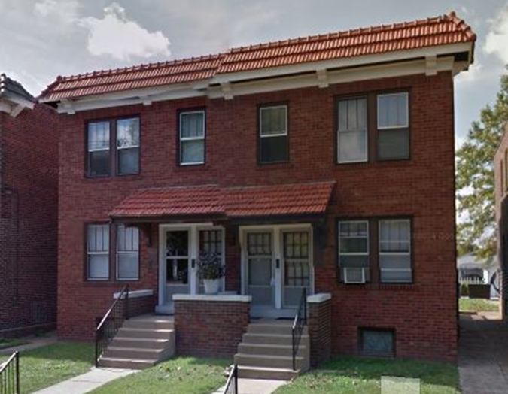
Permanent Supportive Housing
Keyway Center for Diversion and Reentry
Sharon House (Central West End)
$250K funding award 2020
15 units – congregate living
Low-income, post-incarcerated women who struggle with substance use and behavioral health issues
DOORWAYS
Gertrude (Bevo Mill)
Up to $50K funding award 2015
Grant to leverage AHTF forgivable loan
4 units - 1 bedroom
Individuals with HIV/AIDS and behavioral health issues
Notes:
SERENA
Permanent Supportive Housing (PSH) is defined as “a cost-effective combination of permanent, affordable housing with services that help people live more stable, productive lives.”
PSH works well for people who face the most complex challenges – individuals and families who are not only experiencing homelessness, but who also have very low incomes and serious, persistent issues that may include substance use, mental illness, and HIV/AIDS
Since 2011, Saint Louis MHB has supported this goal through its Supporting Housing Initiative, typically providing 10-year forgivable loans to support the creation of PSH units through either renovating existing structures or through construction of new sites that offer behavioral health services in conjunction with permanent housing
To date, MHB has awarded nearly $4.6 million for 21 sites creating 288 new units of permanent supportive housing

Slide 21
Strategic Initiatives

Slide 22
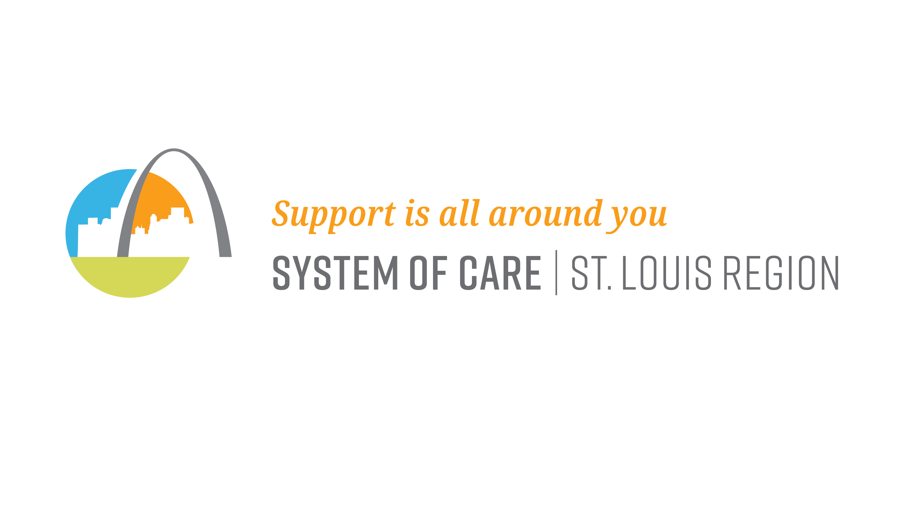
Strategic Initiatives
Role: The System of Care (SOC) is a collaborative network of agencies, families, and youth focused on the total health of children and families with, or at risk for, serious emotional disorders. The SOC supports a family-driven, youth-guided approach to care.
Funding: Substance Abuse and Mental Health Services Administration Cooperative Agreement; $999,897 annually for 4 years through September 29, 2023.
Key Partners: Vision for Children at Risk, St. Louis City and County Family Courts, Places for People, Children’s Advocacy Services of Greater St. Louis, BJC Behavioral Health and ALM Hopewell Center.
Notes:
SERENA
The System of Care is a great example of how MHB can leverage external funding. This federal program is designed for units of government to draw down funding through a cooperative agreement. This is a special funding mechanism that dedicates 30% of its budget to infrastructure, which greatly enhances our ability to advance systems change. This is important because our tax funds are primarily used to support program delivery, but without systems change, programs face an uphill battle in achieving population level impact.
READ SLIDE

Slide 23

Strategic Initiatives
Role: To align, convene, communicate, and connect the organizations addressing Gun Violence Prevention and Reduction.
​
Goal: A reduction in gun related crimes, injuries, and deaths throughout the St. Louis Region focusing on high-risk youth.​
St. Louis Area Violence Prevention Commission Funding:
  Missouri Foundation for Health $500,000 over 5 years
  City of St. Louis Department of Health $1,000,000 over 5 years
  Substance Abuse and Mental Health Services Administration $600,000 for 1 year
  Saint Louis MHB $40,000 annually
Notes:
SERENA
You’ll recall that one of our strategic opportunities focused on maximizing all resources. This means not just focusing on the dollars we can invest, but also paying attention to our ability to convene, plan, and mobilize partners. The VPC is a great example of that type of work. This cross-sector partnership works regionally across multiple sectors to prevent and respond to gun violence. MHB serves as the fiscal sponsor and backbone organization for VPC, but the primary funding sources for VPC are external. MHB provides staff support, the coalition of nearly 60 members plays a critical role in
READ SLIDE

Slide 24
Allocations and
Grant Making

Slide 25
Equitable and Accessible Grantmaking
Applicants really appreciate the technical assistance and availability of staff
“These ladies met me right where I was in the grant seeking process, which was fairly new. They looked past that and saw the passion I had for the work that I do and they helped me channel that into the correct wording in order to apply for this grant. They were simply amazing; never got frustrated. The ladies were very kind in the way they spoke with me and assisted me. They asked questions to provoke me to think and look at my program in different ways, which was truly helpful.”
“The one-on-one support and level of detail/feedback was extremely helpful. All your work to help us was INCREDIBLE! Not every funder does that, so it was greatly appreciated.”
“Staff listened to our thoughts about expanding the programs we were applying for and provided feedback on ways to structure our budget and application.”
Notes:
SERENA
Feedback form our most recently completed CCSF application process this past spring. Emphasize how different our approach is to grantmaking. We don’t just rely on the paper applications. We make ourselves available as a resource so that people have a chance to put their best effort forward.

Slide 26






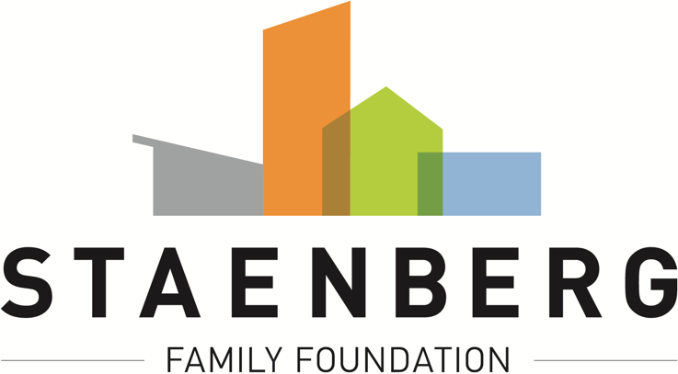

Funded Partner Experience
Our Commitment to the Funded Partner Experience
Communication – Staff Contact, Prompt Response, Proactive Approach
Grantmaking Process – Timeline and Consideration, Consistency, Performance Management
Relationship – You are an Expert, Sharing Resources, Assume Best Intentions
Notes:
SERENA
MHB actively participates in peer funder cohorts to establish and uphold best practices in grantmaking. In 2021, the funders you see here adopted a set of standards that we call the Funded Partner Experience. It articulates our commitment to addressing the inherent power dynamics in grant making by respecting providers as partners in our mission to serve the community. These principles guide how we communicate, how we design our processes, and the value we place in the expertise of our partners who provide direct services.

Slide 27

Grantees as Partners
Simplified reporting process to reduce administrative burden on grantees
Lead staff are available for troubleshooting throughout grant period
Three-year grant cycle with annual renewals to allow for flexibility in program implementation
Outcome-based funding
Notes:
SERENA
Here are a few examples of what we do to engage service providers as partners.
READ Slide

Slide 28


Person Centered Investment Strategy
“Prevention programs which promote healthy lifestyles among children and youth and strengthen families”
Notes:
SERENA
As we’ve discussed, the Trustees have always centered the purpose of the fund in their investment strategies. This quote is taken directly from the ballot language that was used to pass the original children’s service fund tax. While the statute lists types of programs that can be funded, the ballot language communicates the intent of the fund. The community approved a measure to support prevention programs for children, youth, and their families. This philosophy has guided our decision to support afterschool programming and paved the way for our most recent ballot initiative to establish a dedicated early childhood fund.

Slide 29
CMHF Application Cycle
Trustee Key Dates
  February: Grant review training
  March: Joint review team meetings
  April: Trustees make funding decisions
FY24-26 Funding Priorities
Reduce barriers to evidence-based care in clinical and non-clinical settings for groups disproportionately experiencing mental health disorders and substance use disorders.
Provide care at an appropriate level of intensity, consistency, and stability for people with serious mental health disorders and/or substance use disorders.
Notes:
SERENA
Emphasize the importance of actively participating and outline key dates coming up in early 2023. We will provide training, but as new members if you have additional questions, want one-on-one training or need other supports to help you feel prepared, don’t hesitate to ask. We want to make sure that everyone has the information they need to make good decisions and are confident and comfortable in their ability to contribute to the process in a meaningful way.

Slide 30
CMHF By the Numbers
Current FY23 CMHF funding = $2,006,668
12 funded projects/grants
Average grant = $167,222
Range = $31,800 to $262,766
Doesn’t include 4 Hybrid grants allocated at $1,168,180
FY24 - 26 CMHF Application Process
43 Letters of Intent Received
13 LOIs for currently funded projects
28 eligible LOIs from new organizations
Projected FY24 funding available through competitive application process = Approximately $2 million
Notes:
SERENA
Emphasize the current three-year cycle has some inherent challenges. We typically see turnover among some of the currently funded agencies each cycle and it is increasingly competitive for new organizations to get through the door. Equitable distribution of resources is sometimes challenging in a grant driven investment model.

Slide 31
Application Renewals
Staff conduct annual site visits
Organizations submit renewal applications each year
  There are no automatic renewals
  Each cycle organizations compete for funding
  Funding that is unspent is paid back to MHB at the end of the 3-year grant period
Staff review and approve renewal applications internally
  Trustees vote on a resolution to provide for funding all staff approved renewals
Notes:
SERENA

Slide 32
Community Investment Policies
Demonstrate fiscal, administrative and managerial stability, prudence and diligence
Local, state and federal regulatory compliance
Individuals receiving MH services require documented diagnosis except prevention/early intervention
Provide culturally & linguistically appropriate services
Funds may not be used to provide direct / indirect support of any religious education, service, or otherwise assist a religious mission (content neutral manner)
Notes:
CASSANDRA
Next, we want to share a high-level overview of our Community Investment Policies. All funded organizations:
Must demonstrate stability and responsibility in terms of finance, administration, and management.
Must follow all local, state and federal requirements.
For individuals receiving clinical MH services a documented diagnosis is required BUT this does not apply to those receiving prevention or early intervention services
Culturally & linguistically appropriate services must be provided
All services must be provided in a content neutral manner and cannot be used to support of any religious education, service, or mission

Slide 33
Community Investment Policies
MHB funds cannot supplant other revenue sources
Applicants must meet all additional specific eligibility requirements established by specific revenue source (e.g., CMHF)
Maximum $750K for single project/program per FY
Maximum $100K for start-up projects (Year 1)
MO certification or license (e.g., DMH certification, licensed clinicians)
Preferences for accreditation, board member residency in St. Louis City/County, service delivery in City
Link to Community Investment Policies on MHB website
Notes:
CASSANDRA
MHB funds cannot duplicate or replace any other funding received
Specific eligibility requirements for CCSF grants must be met
A maximum request of $750K may be made per program per year
A maximum request of $100K may be made for start-up project in year 1
If your program or service requires MO certification or licensure (e.g., DMH certification, licensed clinicians) MHB requires verification of these credentials
And as a final note, it is preferred that funded organizations are accredited (when possible), board members reside in St. Louis City or County and service delivery occur in the City

Slide 34
MHB Disclaimers
MHB reserves the right to amend, modify or cancel the competitive funding application process in whole or in part if it is deemed to be in the best interest of MHB to do so.
MHB reserves the right to reject any and all applications, to waive formalities, and to select the applications which are, at MHB’s sole discretion and allowed by statute or regulation, in the best interest of MHB.
MHB reserves the right to reject applications that are inconsistent with Missouri statutes and regulations, St. Louis City ordinances or MHB policies and priorities.
MHB reserves the right to negotiate specific terms of an application if it is deemed to be in the best interest of MHB to do so.
MHB reserves the right to require supplemental information or documentation from applicants to clarify and/or verify information provided in the application.
The competitive funding application process does not obligate MHB to select an applicant, pay the costs incurred in preparation of any responses hereto, or to procure or contract for the services or outcomes described herein.
MHB may exercise the foregoing rights at any time without notice and without liability to any applicant or any other party for expenses incurred in the preparation of responses hereto or otherwise. Responses hereto will be prepared at the sole cost and expense of the applicant.
Notes:
CASSANDRA
Trustees make final decisions.
Explain limitations of sunshine law and open records with decision making in public meetings
Now we are going to shift gears from understanding the application requirements to what we are calling ”the fine print” to ensure we are being as transparent as possible and seeking to explain the funding requirements as clearly as we can. Ultimately, MHB makes the best choices it can with the information available, but also like any written document it’s not possible to anticipate every possibility. This may mean that adjustments need to be made along the way and in all cases, we will be transparent whenever we need to course correct.
Our disclaimers listed here outline MHB’s legal authority to make changes as needed to achieve the best outcomes possible for the community. In plain language this statement indicates that:
* The competitive funding application process can be amended, modified or cancelled at anytime
* Any and all applications can be rejected, formalities waived, and then applications selected at MHB’s sole discretion in the best interest of MHB as allowed by state statute or regulation
* Applications that are inconsistent with Missouri statutes and regulations, St. Louis City ordinances, or MHB policies and priorities can be rejected
* Specific terms of an application can be negotiated
* Supplemental information or documentation from applicants to clarify and/or verify information provided in the application may be required
* The competitive funding application process does not mean MHB must select an applicant or pay any expenses associated with application preparation
* And finally any of the above can happen at any time without notice, without liability, and MHB is not responsible for any associated expenses

Slide 35
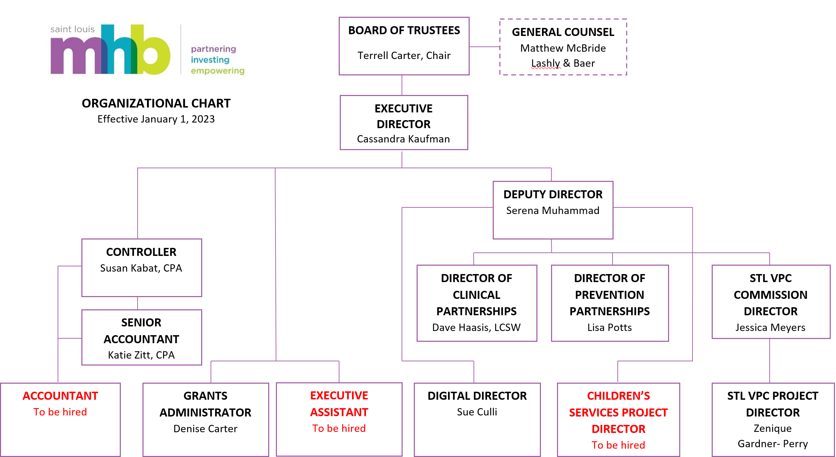
Saint Louis MHB Staff
Notes:
CASSANDRA

